Slide 1
Creating Consistent UI with Xamarin.Forms Visual
David Ortinau
@davidortinau
Senior Program Manager, Xamarin Mobile SDKs

Slide 2
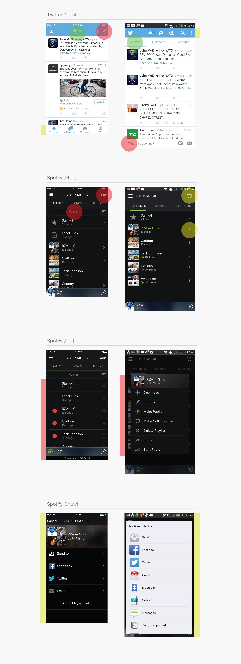
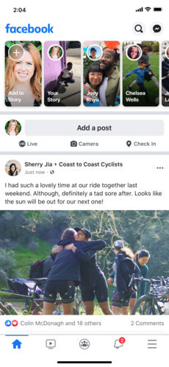
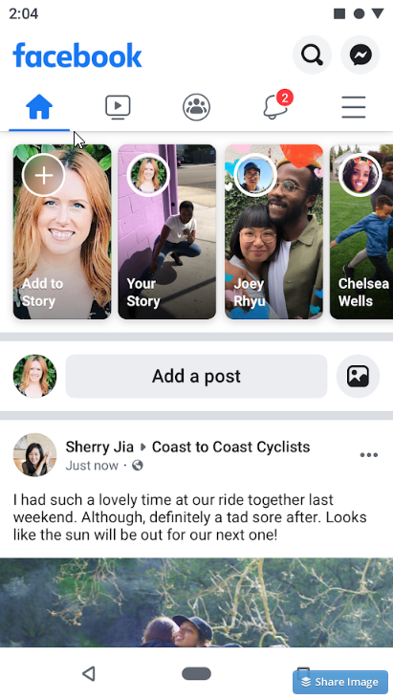
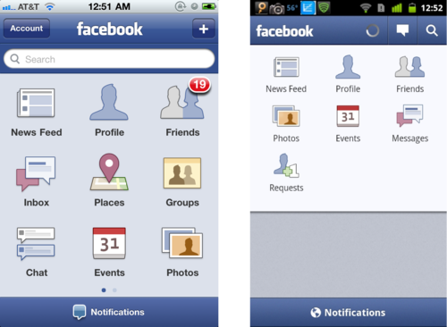
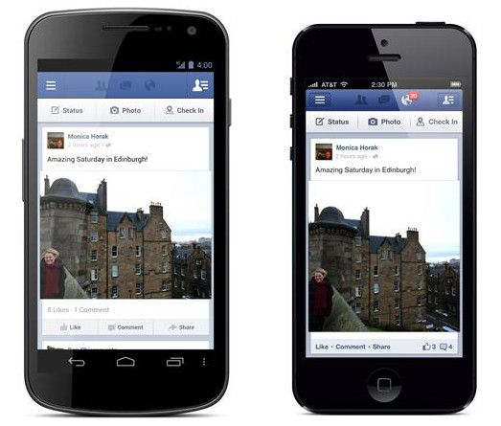
2011
Today
Notes:
http://www.jackrabbitmobile.com/wp-content/uploads/2014/12/ios_vs_android.pdf

Slide 3
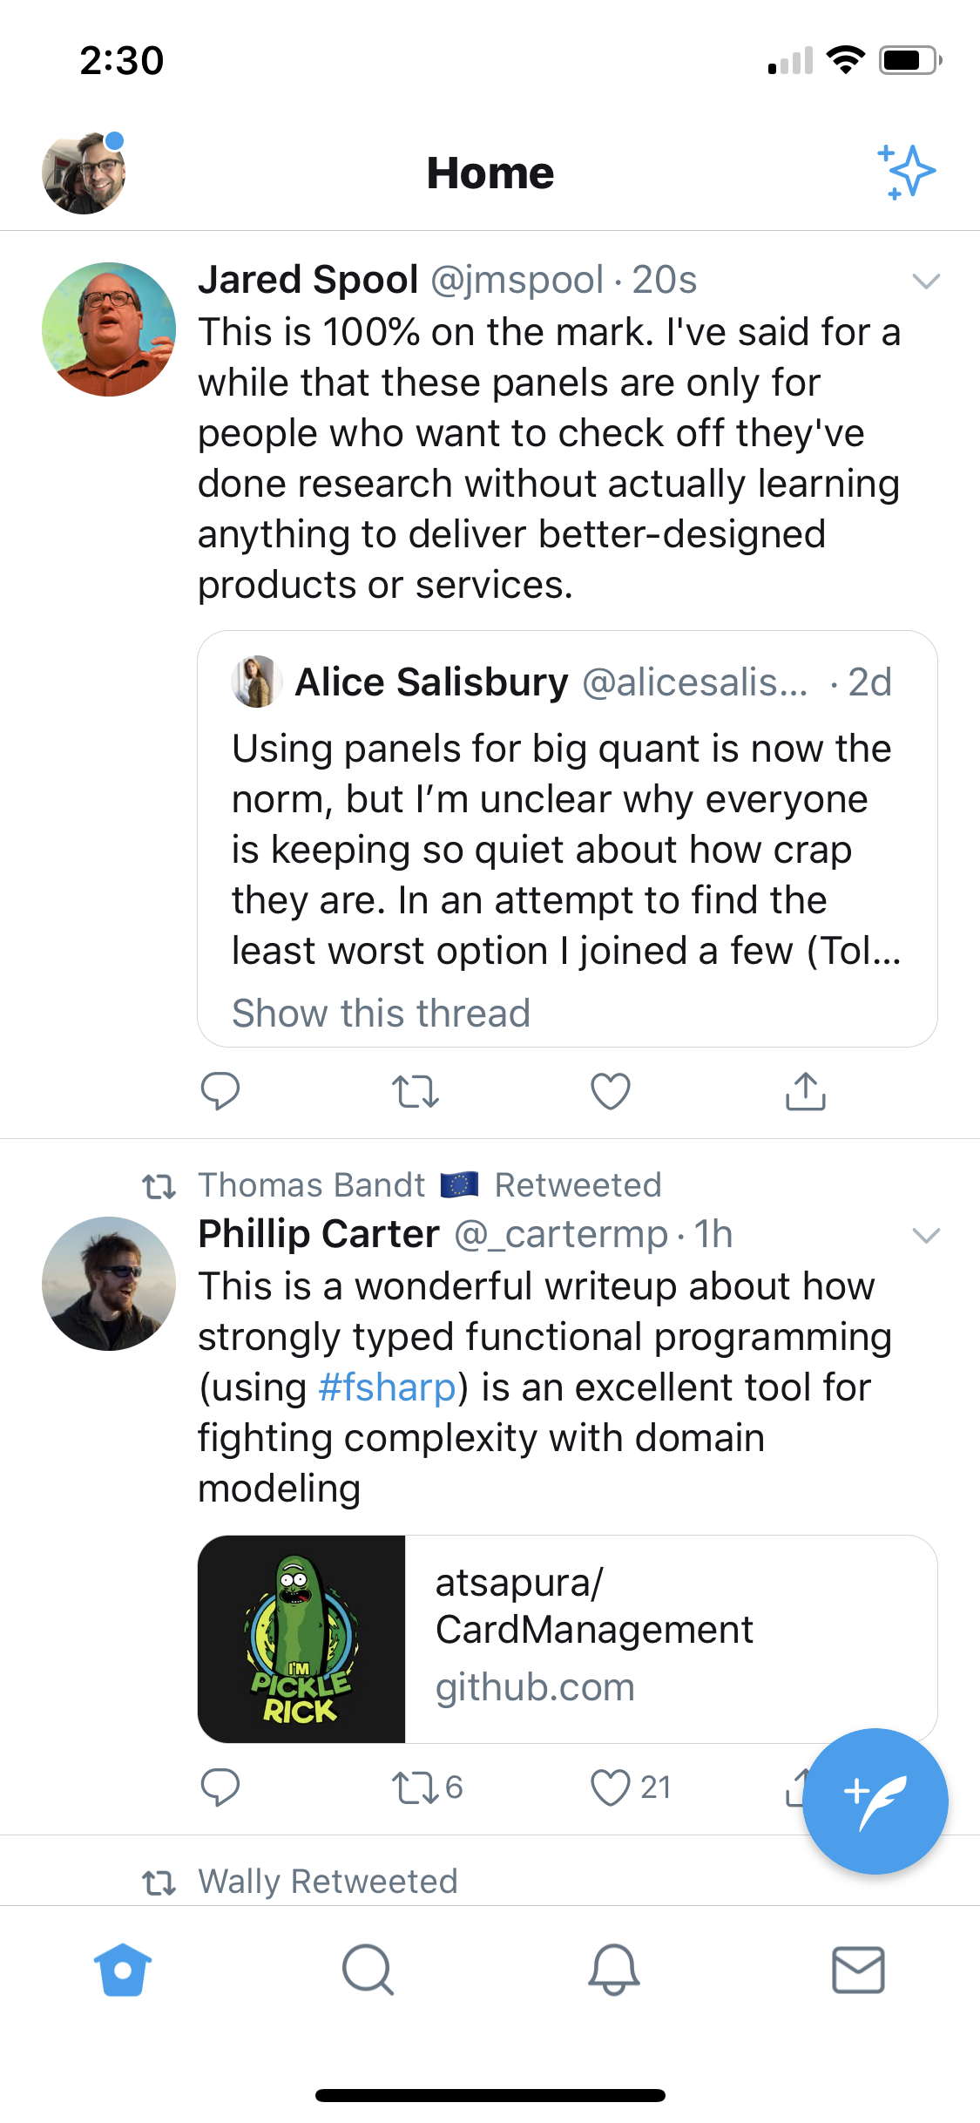
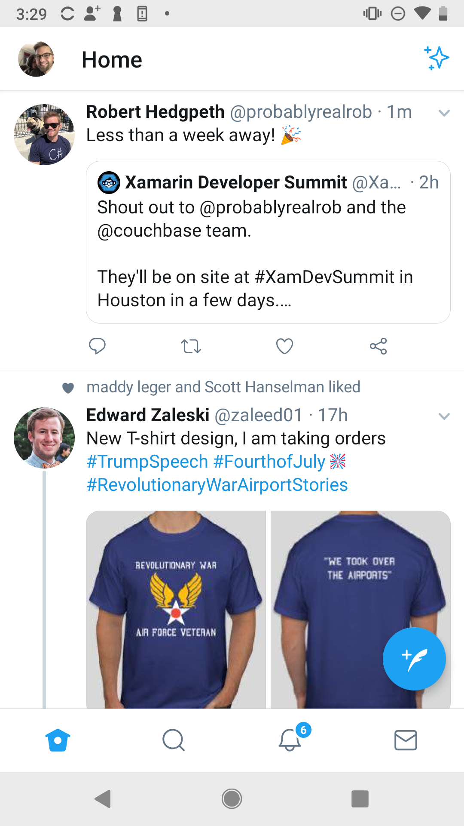
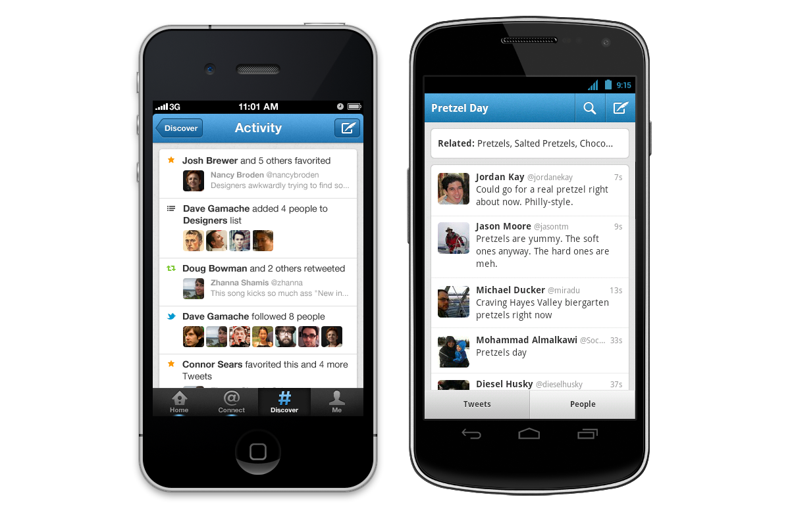
2011
Today

Slide 4
What Is Your Design Objective
All projects over the past year based on real-world customer data.

Slide 5
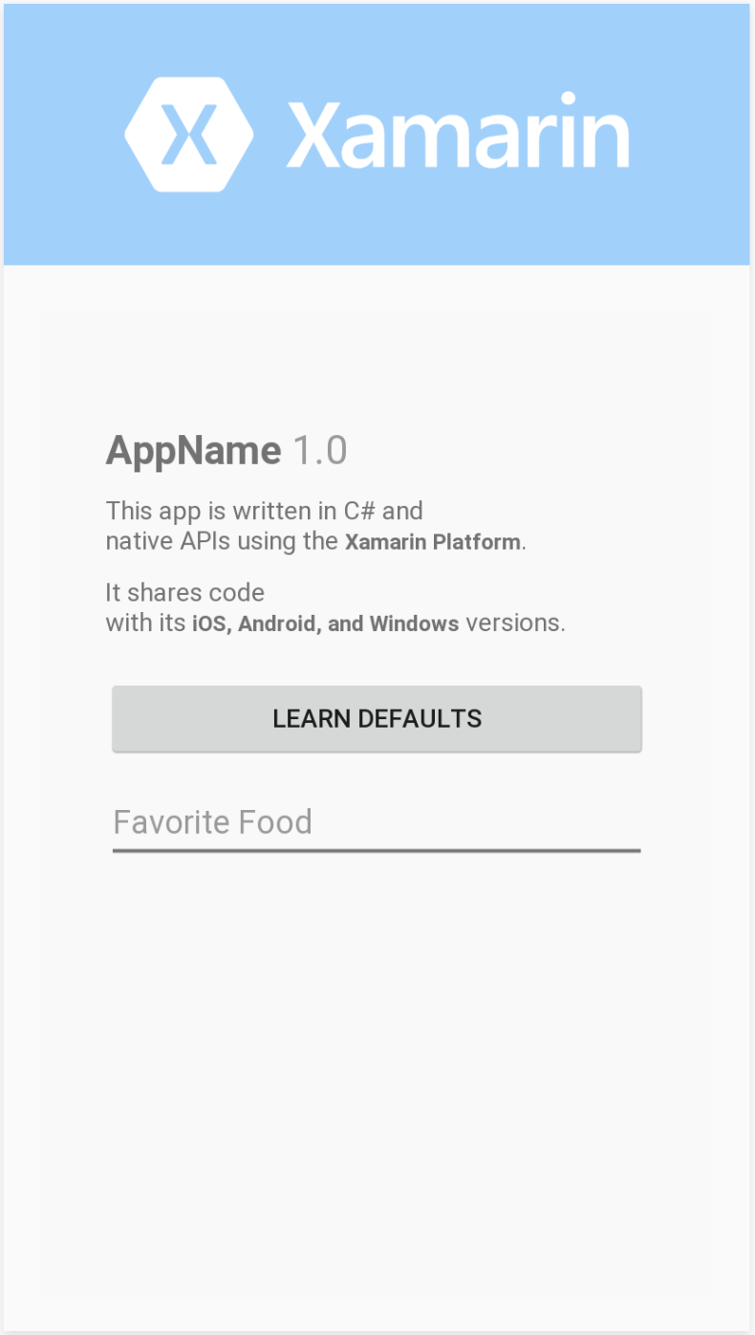
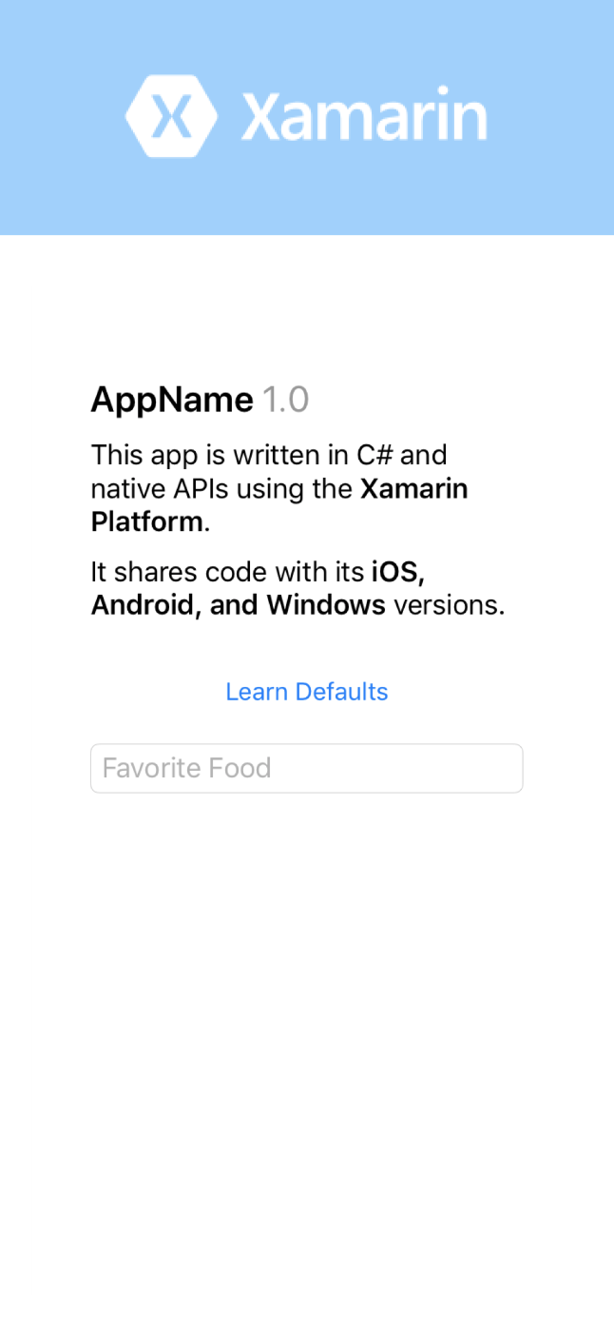
And So It Begins…
Google Says
Apple Says

Slide 6

And So It Begins…
Google Says
Apple Says

Slide 7

And So It Begins…
Google Says
Apple Says

Slide 8
And So It Begins…
Google Says
Apple Says

Slide 9
And So It Begins…
Google Says
Apple Says

Slide 10

And So It Begins…
Google Says
Apple Says

Slide 11
Controls
Custom Renderers
OnPlatform
Styles
Effects
Behaviors
Third Party Controls
Skia
Custom Controls
PlatformSpecifics
???????

Slide 12
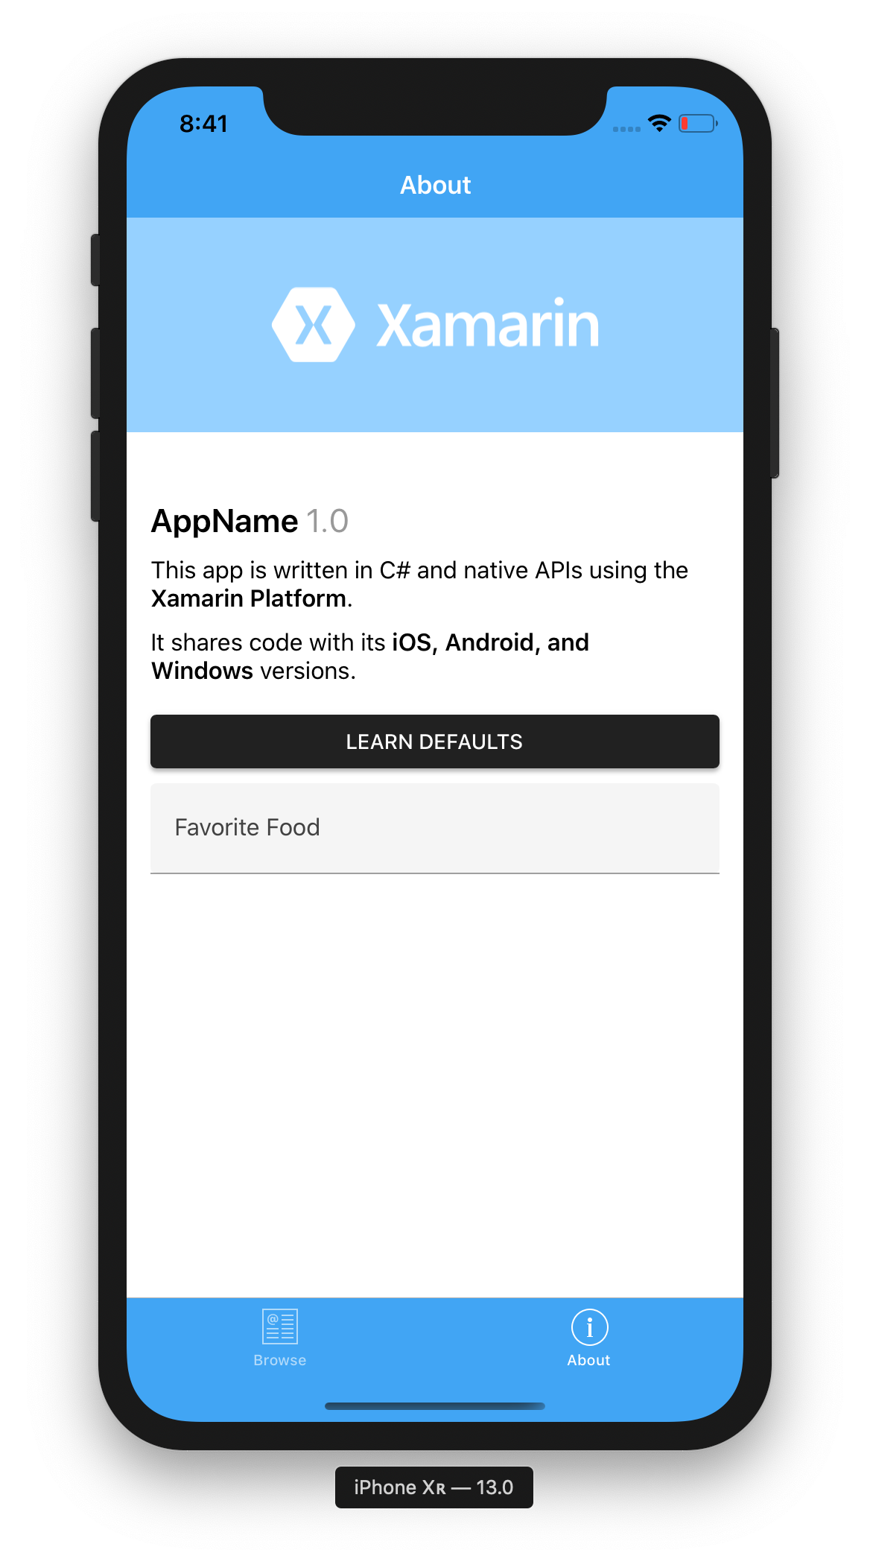
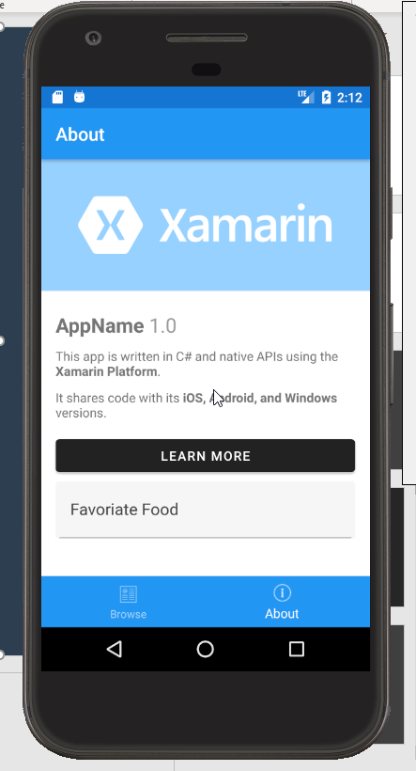
Introducing Visual
Notes:
What Visual is by itself

Slide 13
Why Consistency Matters

Slide 14
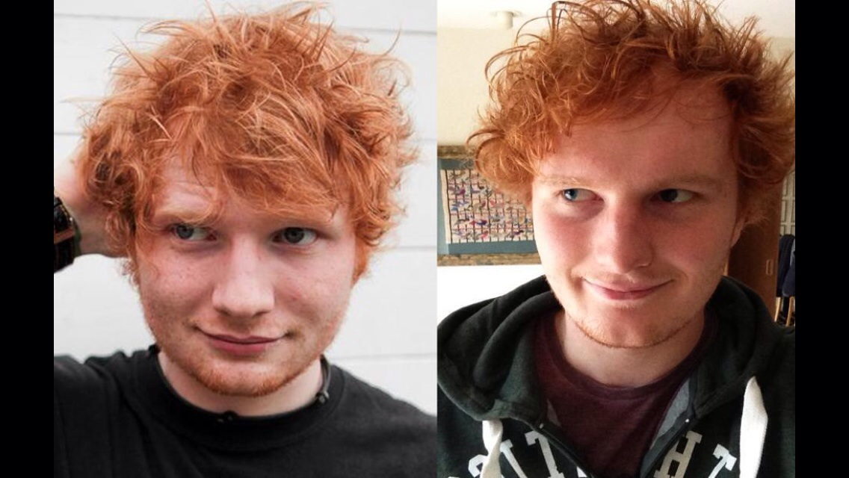

Slide 16
Why?
“Our customers are elderly and when they call in for support, we want to know our instructions are consistent no matter the device.”

Slide 17
Why?
“Our customers are elderly and when they call in for support, we want to know our instructions are consistent no matter the device.”
“By supporting one UI we can move faster than our competition.”

Slide 18
Why?
“Our customers are elderly and when they call in for support, we want to know our instructions are consistent no matter the device.”
“By supporting one UI we can move faster than our competition.”
“Our company supports many apps, so sharing more code means less burden of support.”

Slide 19
Why?
“Our customers are elderly and when they call in for support, we want to know our instructions are consistent no matter the device.”
“By supporting one UI we can move faster than our competition.”
“Our company supports many apps, so sharing more code means less burden of support.”
“To get approved by the regulatory body (FDA).”

Slide 20
Enter Visual

Slide 21
Visual
A simple API to change the renderer used to render a control at runtime to more closely match your design objectives.
Renderers are built to express specific design guidelines:
Apple Human Interface Guidelines
Google Android Holo
Google Material Design
Microsoft Fluent Design

Slide 22
Material Visual
Visual="Material"
Notes:
What Material provides, how it works
What’s next for Material
Properties for styling
What additional controls are needed/desired

Slide 23
Demo: File New

Slide 24
Material Visual
[assembly: ExportRenderer(typeof(Xamarin.Forms.Button),
typeof(MaterialButtonRenderer),
new[] { typeof(VisualMarker.MaterialVisual) })
]
namespace Xamarin.Forms.Material.Android
{
public class MaterialButtonRenderer : MButton, ...
{
Notes:
What Material provides, how it works
What’s next for Material
Properties for styling
What additional controls are needed/desired

Slide 25
Material Visual
[assembly: ExportRenderer(typeof(Xamarin.Forms.Button),
typeof(MaterialButtonRenderer),
new[] { typeof(VisualMarker.MaterialVisual) })
]
namespace Xamarin.Forms.Material.Android
{
public class MaterialButtonRenderer : MButton, ...
{
Notes:
What Material provides, how it works
What’s next for Material
Properties for styling
What additional controls are needed/desired

Slide 26
Material Visual
[assembly: ExportRenderer(typeof(Xamarin.Forms.Button),
typeof(Xamarin.Forms.Material.iOS.MaterialButtonRenderer),
new[] { typeof(VisualMarker.MaterialVisual) })
]
namespace Xamarin.Forms.Material.iOS
{
public class MaterialButtonRenderer :
ViewRenderer<Button, MButton>, ...
Notes:
What Material provides, how it works
What’s next for Material
Properties for styling
What additional controls are needed/desired

Slide 27
Material Visual
[assembly: ExportRenderer(typeof(Xamarin.Forms.Button),
typeof(Xamarin.Forms.Material.iOS.MaterialButtonRenderer),
new[] { typeof(VisualMarker.MaterialVisual) })
]
namespace Xamarin.Forms.Material.iOS
{
public class MaterialButtonRenderer :
ViewRenderer<Button, MButton>, ...
Notes:
What Material provides, how it works
What’s next for Material
Properties for styling
What additional controls are needed/desired

Slide 28
Material Visual
namespace Xamarin.Forms
{
public static class FormsMaterial
{
public static void Init(Context context, Bundle bundle)
{
// my only purpose is to exist so when called
// this dll doesn't get removed
VisualMarker.RegisterMaterial();
}
}
}
Notes:
In each platform project to ensure the dll isn’t linked out.

Slide 29
Visual Challenge
https://github.com/davidortinau/VisualChallenge

Slide 30
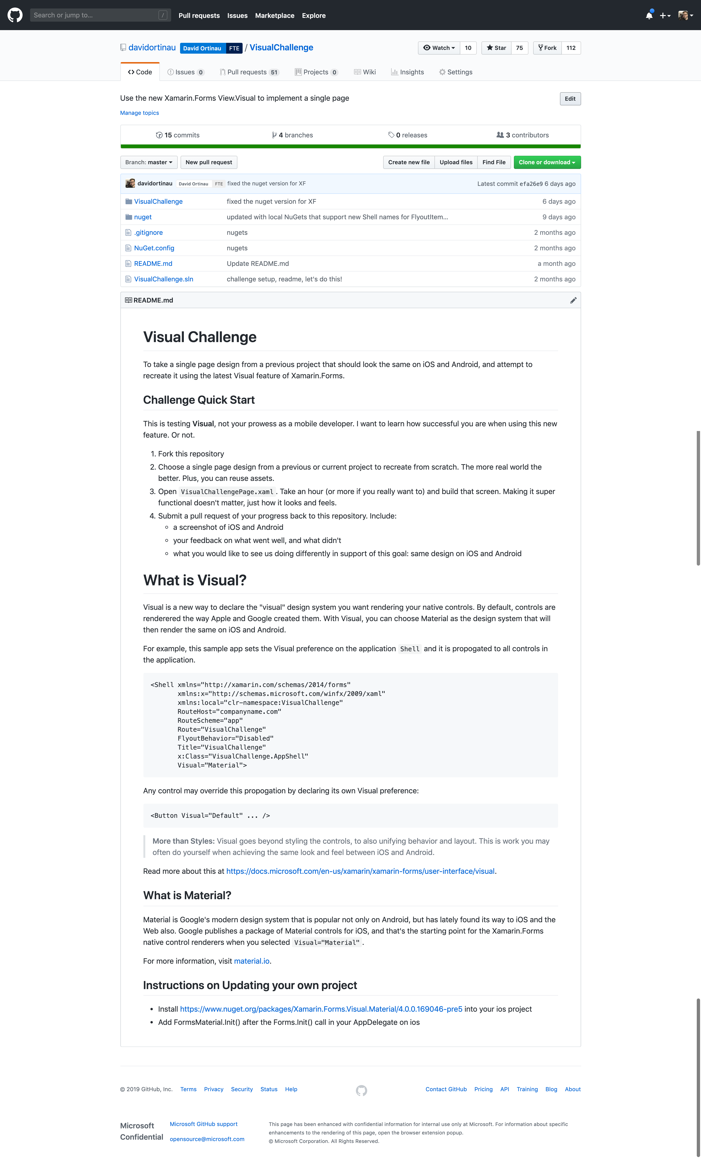
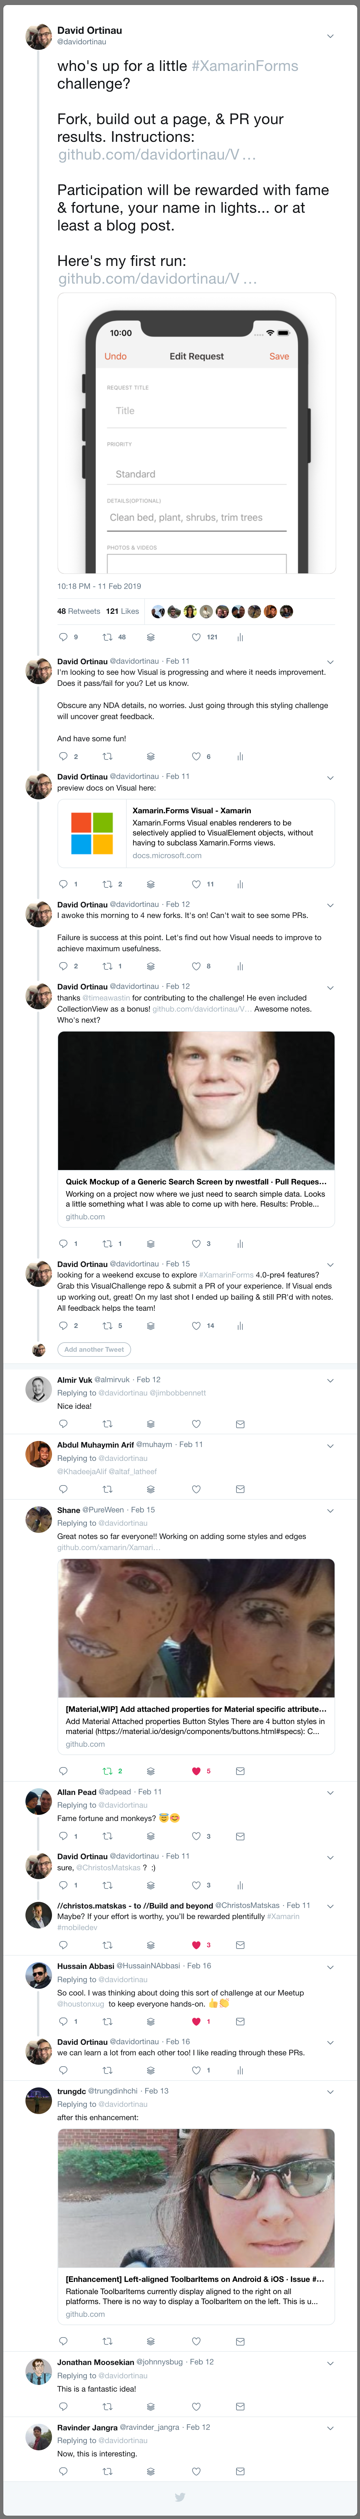

Slide 31
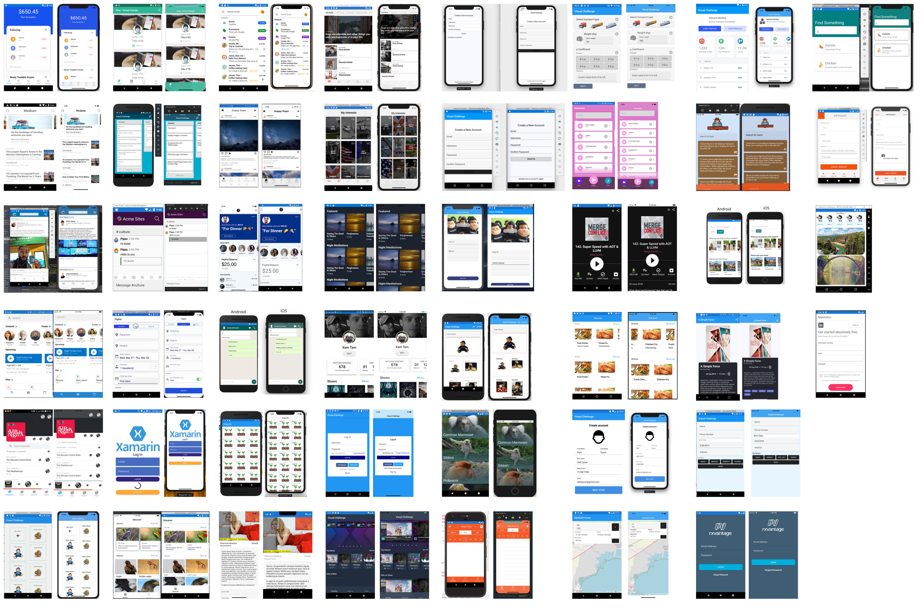
STATISTICS
(Feb 11 Genesis)
March 22 Blog Kickoff
March 31 Closed
9 Days
40 Participants
215+ feedback + code repros
115 Forks
51 Pull Requests
2 meetups
2 live streams (4hrs 12min)

Slide 32
Thanks!
Any Questions?
david.ortinau@microsoft.com
@davidortinau | twitch.tv/davidortinau

